Slide 1


MINOR PROJECT
Project on Criminal Face Recognition
Submitted To:
Mr. Shekhar chandra
Submitted by :
Ashish swami(20MCLN009) and
Prashant Yadav(20MCIN007)
MCA – 2nd SEM SEC - B

Slide 2
CONTENT:
INTRODUCTION TO TOPIC
INTRODUCTION TO ELEMENTS AND TERMS
PROJECT PURPOSE AND SCOPE
PROJECT REQUIREMENTS
PROJECT FEATURES
PROJECT WORKING
CODE
USE OF CNN

Slide 3
Face Recognition
Introduction:
Face is most commonly used biometric to recognize people. Face recognition has received substantial attention from researchers due to human activities found in various applications of security like airport, criminal detection, face tracking, forensic etc. Compared to other biometric traits like palm print, Iris, finger print etc., face biometrics can be non-intrusive. They can be taken even without user’s knowledge and further can be used for security based applications like criminal detection, face tracking, airport security, and forensic surveillance systems. Face recognition involves capturing face image from a video or from a surveillance camera. T

Slide 4
CRIMINAL FACE RECOGNITION
Introduction:
Criminal face recognition involves detection of particular face that is stored in database to the live feed. For that Test images are given to the machine and is trained. So face biometrics is used. Face biometrics involves training known images, classify them with known classes and then they are stored in the database. When a test image is given to the system it is classified and compared with stored database

Slide 5
INTRODUCTION TO BASIC TERMS USED IN PROJECT:
Python language: The backend code is developed using python language as it is easier and time saving plus various functions and libraries available such as NumPy, sys function, os, etc.
HTML,CSS and PHP : The frontend of the project will be developed using these languages.

Slide 6
OPENCV :
OpenCV is the most popular library for computer vision. Originally written in C/C++, it now provides bindings for Python. OpenCV uses machine learning algorithms to search for faces within a picture. OpenCV comes with a number of built-in cascades for detecting everything from faces to eyes to hands to legs. There are even cascades for non-human things.
What’s a cascade?

Slide 7
CASCADE :
OpenCV cascade breaks the problem of detecting faces into multiple stages. For each block, it does a very rough and quick test. If that passes, it does a slightly more detailed test, and so on. The algorithm may have 30 to 50 of these stages or cascades, and it will only detect a face if all stages pass.
WHICH CASCADE CLASSIFIER WILL BE USED?

Slide 8
Haarcascade_frontalface_default :
Haar Cascade is a machine learning-based approach where a lot of positive and negative images are used to train the classifier. Positive images – These images contain the images which we want our classifier to identify. Negative Images – Images of everything else, which do not contain the object we want to detect.
Here this file is used as only front face will be used in process.
WHICH ALGORITHM WILL BE USED ?

Slide 9
The Local Binary Pattern Histogram(LBPH) algorithm:
This algo is a simple solution on face recognition problem, which can recognize both front face and side face.
The LBPH uses 4 parameters – Radius, Neighbors, Grid X and Grid Y. The algorithm uses a concept of a sliding window, based on the parameters radius and neighbors. THE algo converts images into several histograms. So to find the image that matches the input image we just need to compare two histograms and return the image with the closest histogram.

Slide 10
PROJECT PURPOSE AND SCOPE:
Criminal Face Detection System project aims to build a Criminal Face Detection system by levering the human ability to recall minute facial details. ... In such cases it is useful to show witnesses slices of the face like the nose, ears, lips, eyes. etc to see which triggers memory.
The scope of the project is confined to store the image and store in the database. When a person has to be identified the images stored in the database are compared with the existing details

Slide 11
PROJECT REQUIREMENTS:
Hardware req: webcam, system with atleast 1 gb ram, keyboard.
Software req: python v3, Opencv(v4.5.1) or newer , a web browser,

Slide 12
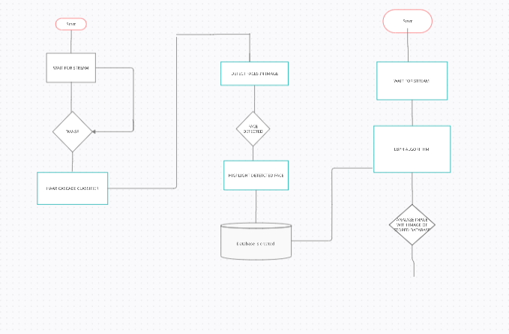
PROJECT FEATURES:
ER DIAGRAM:

Slide 13
PROJECT WORKING:

Slide 14
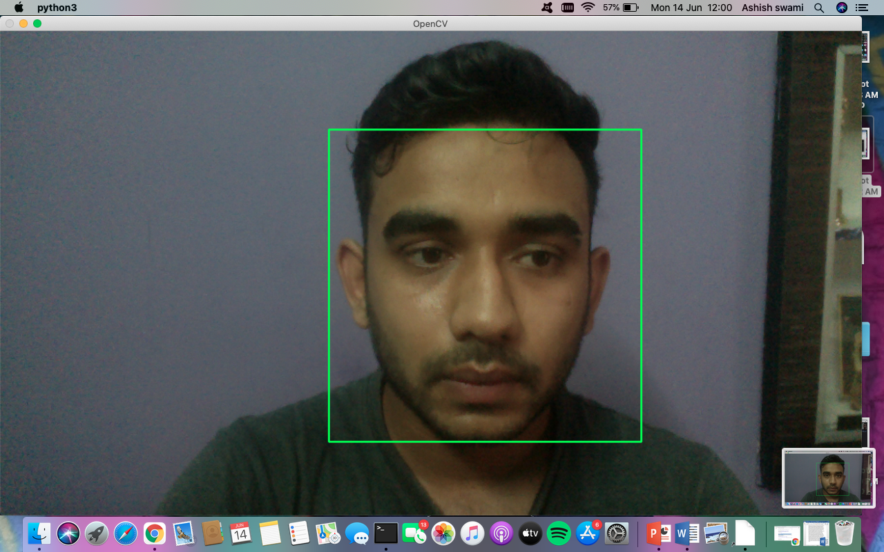
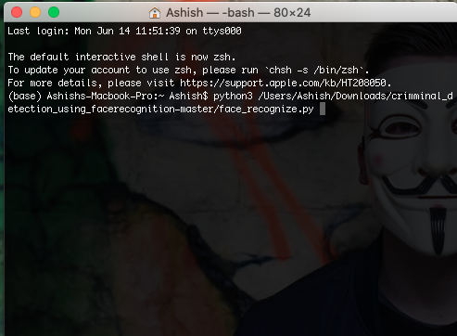
DATABASE CREATION:

Slide 15
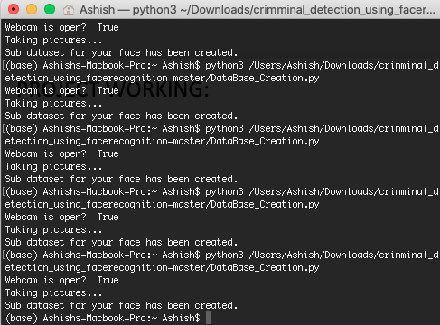
DATABASE IS CREATED

Slide 16
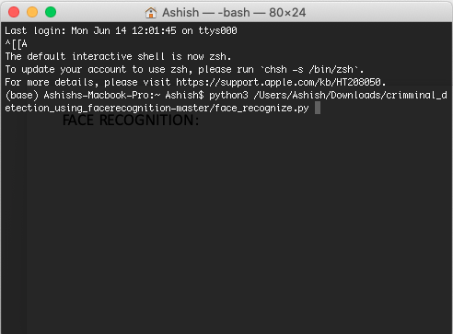
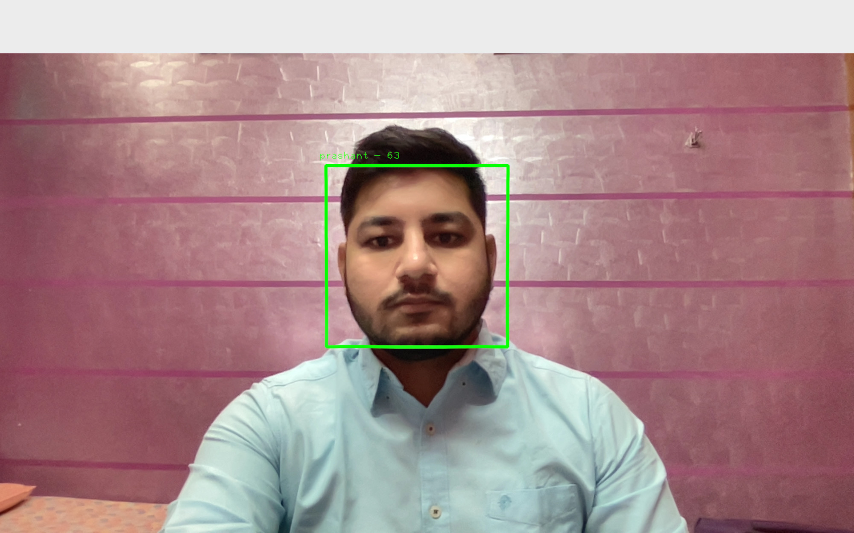
FACE RECOGNITION:

Slide 18
CODE

Slide 19
DATABASE CREATION
#Creating database
import cv2, sys, numpy, os
haar_file = ' /Users/Ashish/Desktop/detection/haarcascade_frontalface_default.xml'
# All the faces data will be
datasets = '/Users/Ashish/Desktop/detection/datasets'
sub_data = '/Users/Ashish/Desktop/detection/datasets/ashish'
path = os.path.join(datasets, sub_data)
if not os.path.isdir(path):
os.mkdir(path)
# defining the size of images
(width, height) = (130, 100)

Slide 20
#'0' is used for my webcam, face_cascade = cv2.CascadeClassifier('/Users/Ashish/Desktop/detection/haarcascade_frontalface_default.xml') webcam = cv2.VideoCapture(0) # The program loops until it has 30 images of the face. count = 1 while count < 30: (_, im) = webcam.read() gray = cv2.cvtColor(im, cv2.COLOR_BGR2GRAY) faces = face_cascade.detectMultiScale(gray, 1.3, 4) for (x, y, w, h) in faces: cv2.rectangle(im, (x, y), (x + w, y + h), (255, 0, 0), 2) face = gray[y:y + h, x:x + w] face_resize = cv2.resize(face, (width, height)) cv2.imwrite('%s/%s.png' % (path, count), face_resize) count += 1 cv2.imshow('OpenCV', im) key = cv2.waitKey(10) if key == 27: break

Slide 21
Face Recognition
import cv2, sys, numpy, os
size = 4
haar_file = '/Users/Ashish/Desktop/detection/haarcascade_frontalface_default.xml'
datasets = '/Users/Ashish/Desktop/detection/datasets/'
print('Recognizing Face Please Be in sufficient Lights...')
# Creating a list of images and a list of corresponding names
(images, lables, names, id) = ([], [], {}, 0)
for (subdirs, dirs, files) in os.walk(datasets):
for subdir in dirs:
names[id] = subdir
subjectpath = os.path.join(datasets, subdir)
for filename in os.listdir(subjectpath):
path = subjectpath + '/' + filename
lable = id
images.append(cv2.imread(path, 0))
lables.append(int(lable))
id += 1

Slide 22
width, height) = (130, 100) # Create a Numpy array from the two lists above (images, lables) = [numpy.array(lis) for lis in [images, lables]] # training a model from the images model = cv2.face.LBPHFaceRecognizer_create() model.train(images, lables) face_cascade = cv2.CascadeClassifier(haar_file) webcam = cv2.VideoCapture(0) while True: (_, im) = webcam.read() gray = cv2.cvtColor(im, cv2.COLOR_BGR2GRAY) faces = face_cascade.detectMultiScale(gray, 1.2, 5) for (x, y, w, h) in faces: cv2.rectangle(im, (x, y), (x + w, y + h), (255, 0, 0), 2) face = gray[y:y + h, x:x + w] face_resize = cv2.resize(face, (width, height)) # recognize the face prediction = model.predict(face_resize) cv2.rectangle(im, (x, y), (x + w, y + h), (0, 255, 0), 3) if prediction[1]<500:

Slide 23
cv2.putText(im, '% s - %.0f' % (names[prediction[0]], prediction[1]), (x-10, y-10), cv2.FONT_HERSHEY_PLAIN, 1, (0, 255, 0)) else: cv2.putText(im, 'not recognized', (x-10, y-10), cv2.FONT_HERSHEY_PLAIN, 1, (0, 255, 0)) cv2.imshow('OpenCV', im) key = cv2.waitKey(10) if key == 27: break

Slide 24
Shuffling of Data:
Random and tqdm library will be imported
import os
from random import shuffle
from tqdm import tqdm
def my_data():
data = []
for img in tqdm(os.listdir("/datasets")):
path=os.path.join("/datasets",img)
img_data = cv2.imread(path, cv2.IMREAD_GRAYSCALE)
img_data = cv2.resize(img_data, (50,50))
data.append([np.array(img_data), my_label(img)])
shuffle(data)
return data

Slide 25
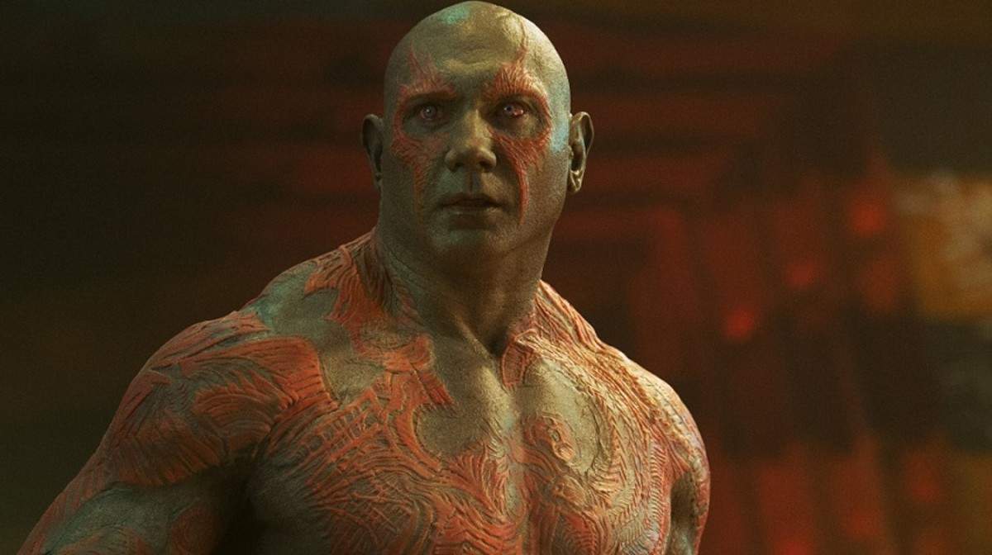
USE OF CNN
I’ll do you one better,
Why is CNN

Slide 26
USE OF CNN
import tensorflow as tf
import tflearn
import cv2 import Rectangle
from matplotlib.patches import Rectangle
from matplotlib import pyplot
from mtcnn.mtcnn import MTCNN
Import Keras

Slide 27
# loading image from file
filename = ‘/Users/Ashish/Desktop/project/test1.jpeg'
pixels = pyplot.imread(filename)
# creating the detector
detector = MTCNN()
# detecting faces in the image
faces = detector.detect_faces(pixels)
for face in faces:
print(face)
fro result in result_list:
# cretin th cordnts
x, y, width, height = result['box']
# creating the shape
rect = Rectangle((x, y), width, height, color='red')

Slide 28
# drawing the rect on imagge
def draw_image(filename, result_list):
data = pyplot.imread(filename)
# plot the image
pyplot.imshow(data)
# plot each box
for result in result_list:
x, y, width, height = result['box']
rect = Rectangle((x, y), width, height, color='red')
# show the plot
pyplot.show()

Slide 29
the folder where images are
TrainingImagePath="/Users/Ashish/Desktop/project/datasets"
def training ( ) :

Slide 30
Working on DEEP learning
Part 1: Initializing
import dlib import scipy.misc import numpy as np import os
face_detector = dlib.get_frontal_face_detector()
shape_predictor = dlib.shape_predictor('shape_predictor_68_face_landmarks.dat’)
face_recognition_model=dlib.face_recognition_model_v1('dlib_face_recognition_resnet_model_v1.dat’)
path_to_image="/Users/Ashish/Desktop/project/deep learning/images"

Slide 31
Part 2: Get face encodings from an image
# This take an image and return its face encodings using the neural network def get_face_encodings(path_to_image):
# Loading image using scipy image = scipy.misc.imread(path_to_image)
detected_faces = face_detector(image, 1)
shapes_faces = [shape_predictor(image, face) for face in detected_faces]
return [np.array(face_recognition_model.compute_face_descriptor(image, face_pose, 1)) for face_pose in shapes_faces]

Slide 32
Part 3a: Compare faces
# list of known faces def compare_face_encodings(known_faces, face): return (np.linalg.norm(known_faces - face, axis=1) <= TOLERANCE)

Slide 33
Part 3b: Find match
def find_match(known_faces, names, face): matches = compare_face_encodings(known_faces, face)
# Returning the name of the first match count = 0 for match in matches: if match: return names[count] count += 1
return 'Not Found'

Slide 34
Part 4a: Getting face encodings for all faces in the images folder
# Sorting in alphabetical order image_filenames = sorted(image_filenames)
# paths to images paths_to_images = ['images/' + x for x in image_filenames]
# List of face encodings we have face_encodings = []

Slide 35
Part 4b: Matching each image in test folder with the known faces (one by one)
# Filtering on .jpg extension
test_filenames = filter(lambda x: x.endswith('.jpg'), os.listdir('test/’))

